Slide 1

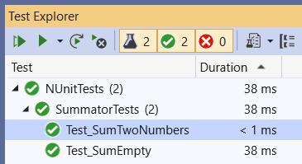
Unit Testing
Unit Testing Concepts. Testing Frameworks. NUnit. Writing Automated Tests with NUnit
SoftUni Team
Technical Trainers
Software University
https://softuni.bg

Slide 2
Table of Contents
What is Unit Testing?
Testing Frameworks
NUnit First Steps
The AAA Pattern – Arrange, Act, Assert
Assertions
Unit Testing Examples
Data-Driven Testing
Code Coverage – How the Tests Cover the Code
Best Practices in Unit Testing
2

Slide 3

What is Unit Testing?
Automated Testing of Software Components (Units)
3

Slide 4
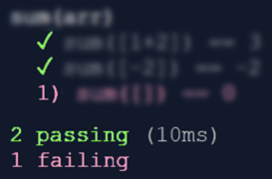
Unit Testing
Unit test == a piece of code that tests specific functionality in certain software component (unit)
int Sum(int[] arr)
{
int sum = arr[0];
for (int i=1; i<arr
.Length; i++)
sum += arr[i];
return sum;
}
void Test_SumTwoNumbers() {
if (Sum(new int[]{1, 2}) != 3)
throw new Exception("1+2 != 3");
}
void Test_SumEmptyArray() {
if (Sum(new int[]{ }) != 0)
throw new Exception("sum [] != 0");
}

Slide 5
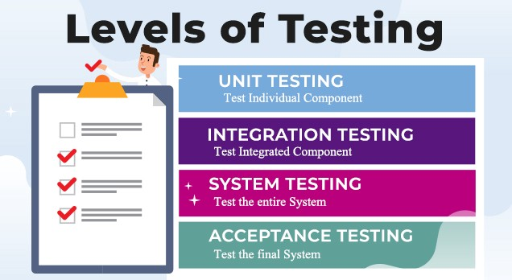
Test Levels
Unit tests
Test a single component (mocking the dependencies)
NUnit, JUnit, PyUnit, Mocha
Integration tests
Test an interaction between components, e. g. API tests
System tests / acceptance tests / end-to-end tests
Test the entire system, e. g. Selenium, Appium, Cypress, Playwright

Slide 6

Testing Frameworks
Concepts
6

Slide 7
Testing Frameworks
Testing frameworks provide foundation for test automation
Consists of libraries, code modules and tools for test automation
Structure the tests into hierarchical or other form
Implement test cases, execute the tests and generate reports
Assert the execution results and exit conditions
Perform initialization at startup and cleanup at shut down
Examples of testing frameworks:
NUnit, xUnit, MSTest (C#), JUnit (Java), Mocha (JS), PyUnit (Python)

Slide 8
Testing Framework – Example
Testing frameworks simplify automated testing and reporting
Example: NUnit testing framework for C#
using NUnit.Framework;
public class SummatorTests
{
[Test]
public void Test_SumTwoNumbers() {
var sum = Sum(new int[] { 1, 2 });
Assert.AreEqual(3, sum);
}
}

Slide 9
Unit Testing Framework vs. Testing Framework
Unit testing framework == automated testing framework == testing framework == test framework
Many names for similar concepts → why?
Testing frameworks like JUnit and NUnit were initially designed for unit testing, but nothing limits them to wider use
With additional libraries, NUnit and JUnit are used for:
Integration testing, API testing, Web service testing
End-to-end testing, Web UI testing, mobile testing, etc.

Slide 10

Setup and First Test

Slide 11

NUnit: Overview
NUnit == popular C# testing framework
Supports test suites, test cases, before & after code, startup & cleanup code, timeouts, expected errors, …
Like JUnit (for Java)
Free, open-source
Powerful and mature
Wide community
Built-in support in Visual Studio
Official site: nunit.org
11

Slide 12
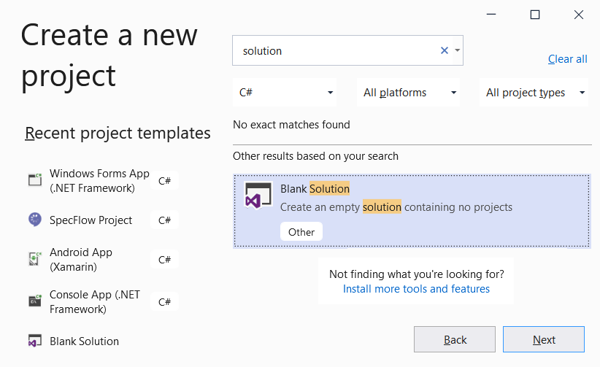
Creating a Blank Solution
Create a blank solution in Visual Studio
It will hold the project for testing
And the unit test project (tests)

Slide 13
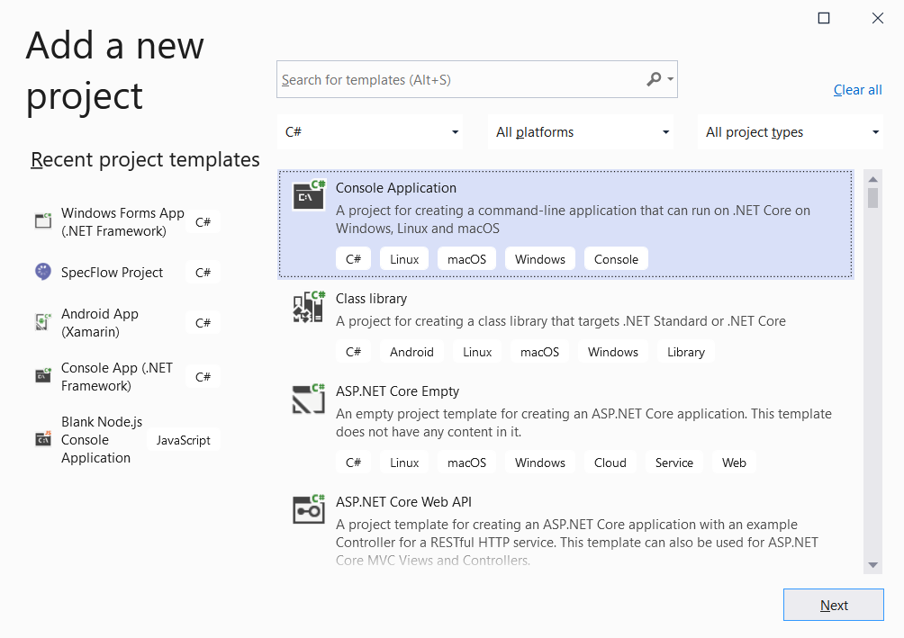
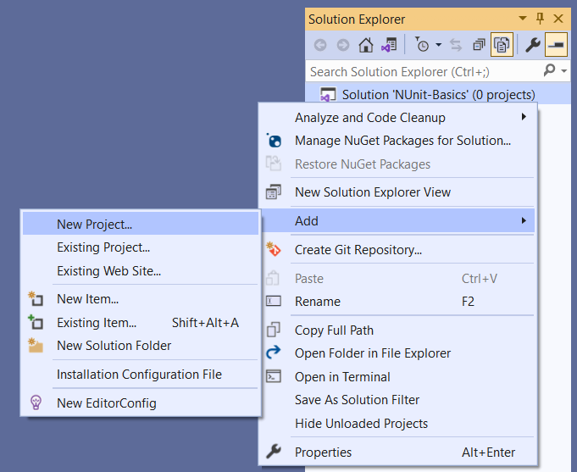
Creating a Project for Testing (1)
Create a console-based app, to hold the code for testing

Slide 14
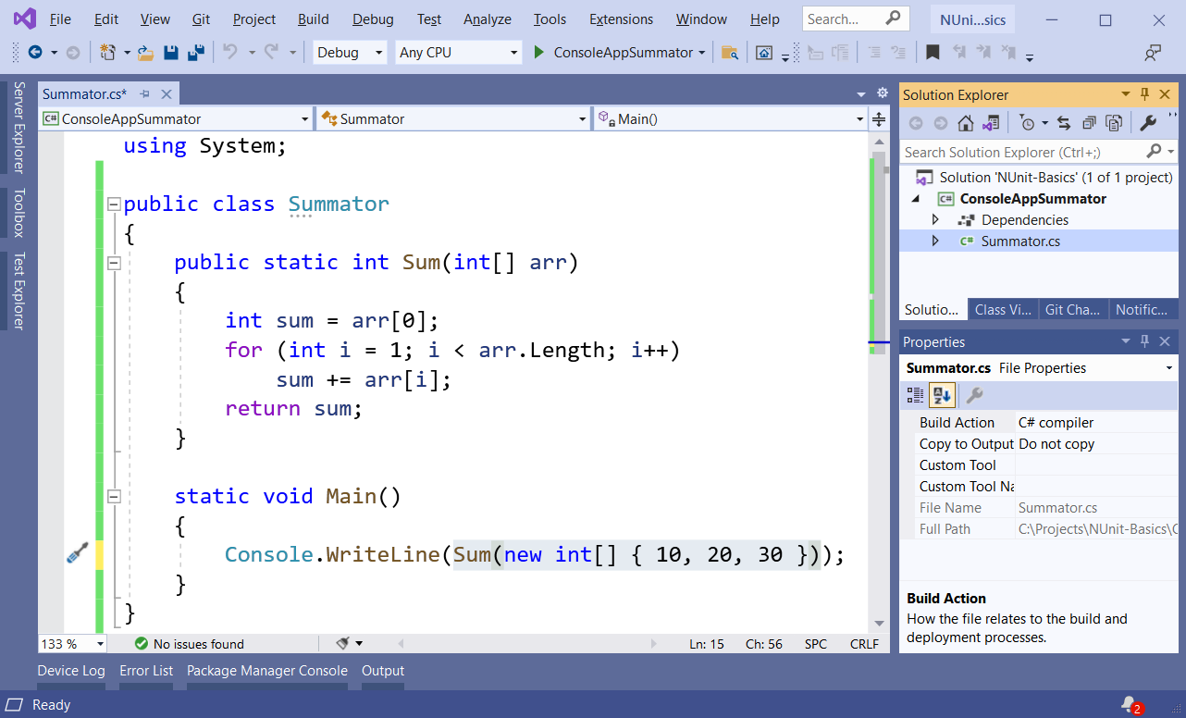
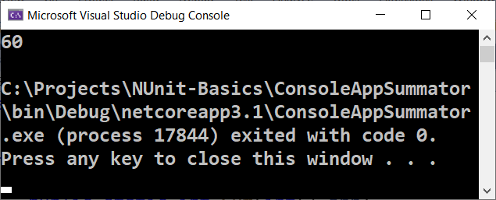
Creating a Project for Testing (2)

Slide 15
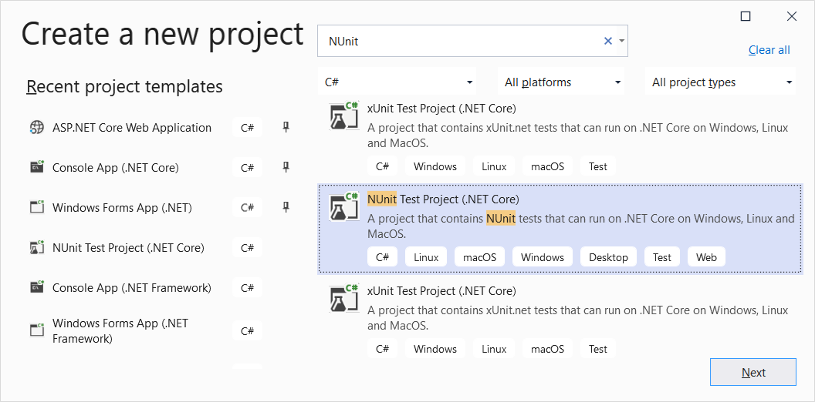
Creating an NUnit Project

Slide 16
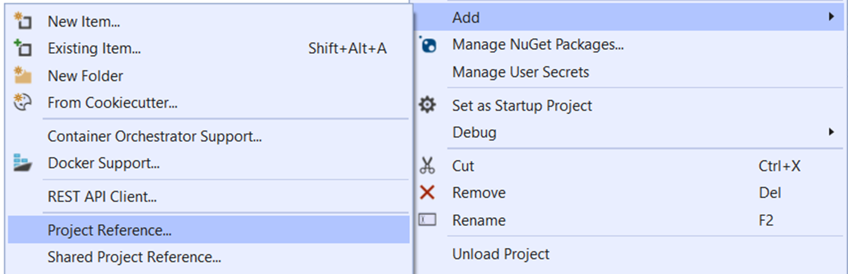
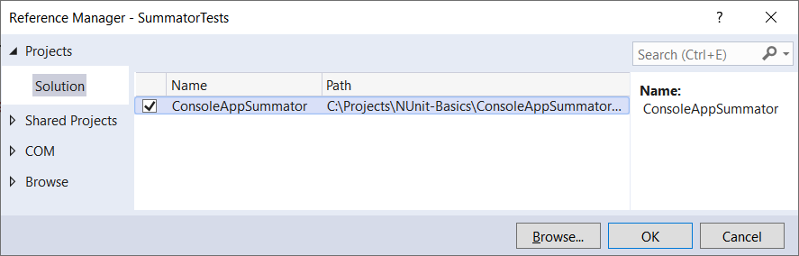
Adding Project Reference
Add Project Reference to the target project for testing:

Slide 17
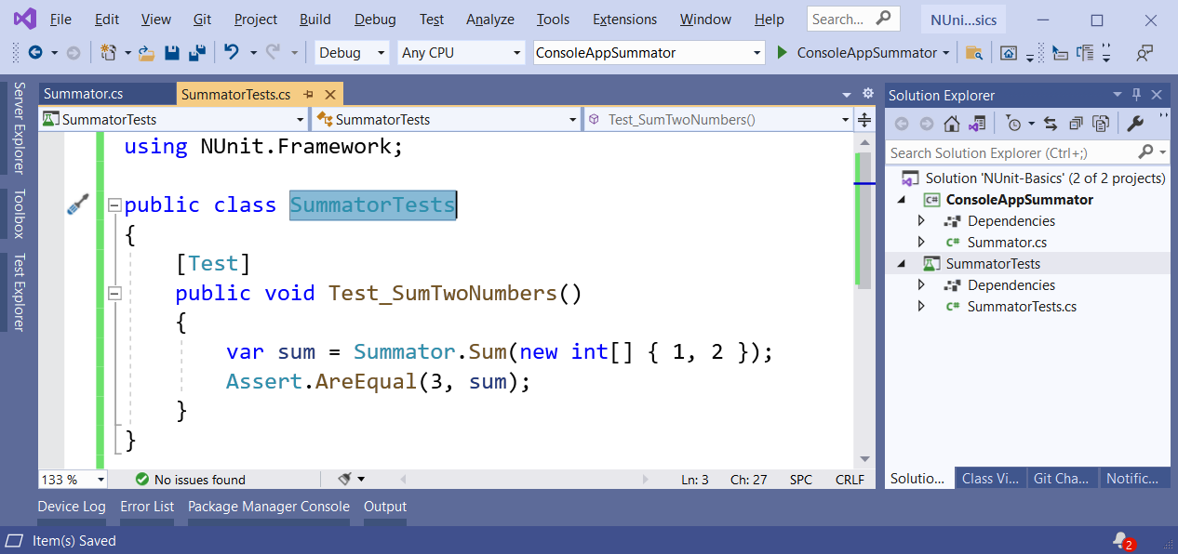
Writing the First Test
Writing the first NUnit test method:

Slide 18
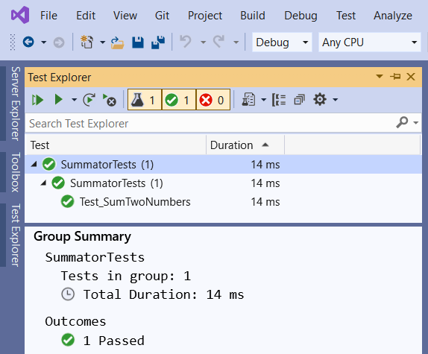
Running the Tests
The [Test Explorer] tool in Visual Studio
Show the [Test Explorer]:
[Ctrl + E] + T
Visualizes the hierarchy of tests
Executes tests
Reports results

Slide 19
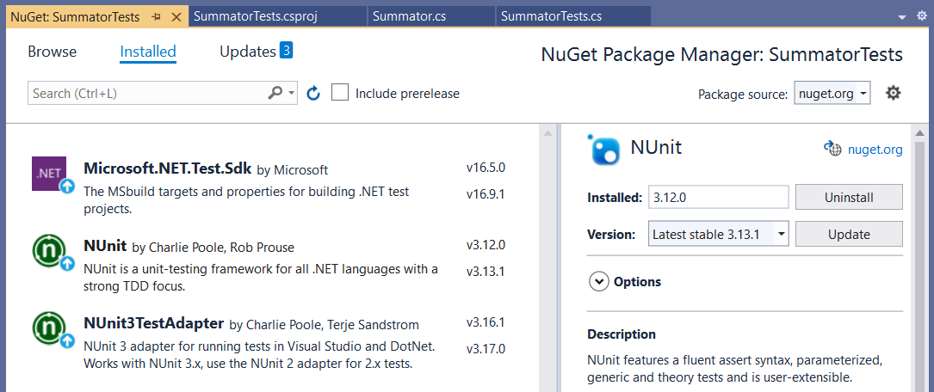
NUnit: NuGet Packages
NuGet packages, required to run NUnit tests in Visual Studio

Slide 20
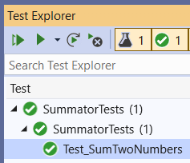
Test Classes and Test Methods
Test classes hold test methods:
Import NUnit
using NUnit.Framework;
[TestFixture]
public class SummatorTests
{
[Test]
public void Test_SumTwoNumbers() {
var sum = Sum(new int[] { 1, 2 });
Assert.AreEqual(3, sum);
}
}
Optional notation
Test class
Test method
Assertion

Slide 21
Initialization and Cleanup Methods
private Summator summator;
[SetUp] // or [OneTimeSetUp]
public void TestInitialize()
{
this.summator = new Summator();
}
[TearDown] // or [OneTimeTearDown]
public void TestCleanup()
{
// …
}
Executes before each test
Executes after each test

Slide 22
Arrange → Act → Assert
AAA

Slide 23
The "AAA" Testing Pattern
Automated tests usually follow the "AAA" pattern
Arrange: prepare the input data and entrance conditions
Act: invoke the action for testing
Assert: check the output and exit conditions
[Test]
public void Test_SumNumbers()
{
// Arrange
var nums = new int[] {3, 5};
// Act
var sum = Sum(nums);
// Assert
Assert.AreEqual(8, sum);
}

Slide 24
Checking the Results and Output Conditions

Slide 25
Assertions (1)
Assert that condition is true
Comparison (equal, greater than, less than or equal, …)
Range assertions
Assert.That(bool condition);
Assert.That(actual, Is.EqualTo(expected));
Assert.AreEqual(expected, actual);
double percentage = 99.95;
Assert.That(percentage, Is.InRange(80, 100));

Slide 26
Assertions (2)
String assertions
Assertions by regex matching
Assertions for expected exception
Assert.That(string actual,
Does.Contain(string expected));
string date = "7/11/2021";
Assert.That(date, Does.Match(@"^\d{1,2}/\d{1,2}/\d{4}$"));
Assert.That(() => { code },
Throws.InstanceOf<ArgumentOutOfRangeException>());

Slide 27
Assertions (3)
Collection assertions
Collection range assertions
File / directory assertions
Assert.That(IEnumerable expected,
Has.Member(object actual));
var percentages = new int[] { 10, 30, 50, 100 };
Assert.That(percentages, Is.All.InRange(0, 100));
Assert.That(string filePath, Does.Exist);
DirectoryAssert.Exists(string path);

Slide 28
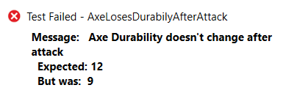
Assertion Messages
Assertions can show messages to helps with diagnostics
Assert.That(axe.DurabilityPoints, Is.EqualTo(12),
"Axe Durability doesn't change after attack");
Failure messages in the tests help finding the problem

Slide 29
Implementing NUnit Test Cases

Slide 30
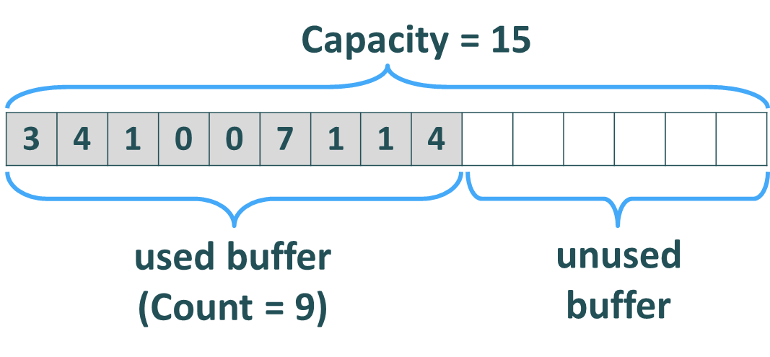
Implement Tests for the Collection<T> Class
public class Collection<T>
{
public int Capacity { … }
public int Count { … }
public Collection(params T[] items) { … }
public void Add(T item) { … }
public void AddRange(params T[] items) { … }
public T this[int index] { … }
public void InsertAt(int index, T item) { … }
public void Exchange(int index1, int index2) { … }
public T RemoveAt(int index) { … }
public void Clear() { … }
public override string ToString() { … }
}
Source code: https://github.com/nakov/UnitTestingExample/blob/main/Collections/Collection.cs

Slide 31
Defining the Tests (1)
public class CollectionTests
{
public void Test_Collection_EmptyConstructor() { … }
public void Test_Collection_ConstructorSingleItem() { … }
public void Test_Collection_ConstructorMultipleItems() { … }
public void Test_Collection_Add() { … }
public void Test_Collection_AddWithGrow() { … }
public void Test_Collection_AddRange() { … }
public void Test_Collection_GetByIndex() { … }
public void Test_Collection_GetByInvalidIndex() { … }
public void Test_Collection_SetByIndex() { … }
public void Test_Collection_SetByInvalidIndex() { … }
…

Slide 32
Defining the Tests (2)
…
public void Test_Collection_AddRangeWithGrow() { … }
public void Test_Collection_InsertAtStart() { … }
public void Test_Collection_InsertAtEnd() { … }
public void Test_Collection_InsertAtMiddle() { … }
public void Test_Collection_InsertAtWithGrow() { … }
public void Test_Collection_InsertAtInvalidIndex() { … }
public void Test_Collection_ExchangeMiddle() { … }
public void Test_Collection_ExchangeFirstLast() { … }
public void Test_Collection_ExchangeInvalidIndexes() { … }
public void Test_Collection_RemoveAtStart() { … }
public void Test_Collection_RemoveAtEnd() { … }
…

Slide 33
Defining the Tests (3)
…
public void Test_Collection_RemoveAtMiddle() { … }
public void Test_Collection_RemoveAtInvalidIndex() { … }
public void Test_Collection_RemoveAll() { … }
public void Test_Collection_Clear() { … }
public void Test_Collection_CountAndCapacity() { … }
public void Test_Collection_ToStringEmpty() { … }
public void Test_Collection_ToStringSingle() { … }
public void Test_Collection_ToStringMultiple() { … }
public void Test_Collection_ToStringNestedCollections() { … }
public void Test_Collection_1MillionItems() { … }
}

Slide 34
Test Cases: Empty Constructor
[Test]
public void Test_Collection_EmptyConstructor()
{
// Arrange
var nums = new Collection<int>();
// Assert
Assert.That(nums.ToString(), Is.EqualTo("[]"));
}
Check your solution here: https://judge.softuni.bg/Contests/Practice/Index/3162#0

Slide 35
Test Constructor with Single / Multiple Items
[Test]
public void Test_Collection_ConstructorSingleItem()
{
var nums = new Collection<int>(5);
Assert.That(nums.ToString(), Is.EqualTo("[5]"));
}
[Test]
public void Test_Collection_ConstructorMultipleItems()
{
var nums = new Collection<int>(5, 10, 15);
Assert.That(nums.ToString(), Is.EqualTo("[5, 10, 15]"));
}

Slide 36
Implementing Test Cases: Add
public void Test_Collections_Add()
{
// Arrange
var nums = new Collection<int>();
// Act
nums.Add(5);
nums.Add(6);
// Assert
Assert.That(nums.ToString(), Is.Equal("[5, 6]"));
}

Slide 37
Implementing Test Cases: Add Range + Grow
[Test]
public void Test_Collection_AddRangeWithGrow()
{
var nums = new Collection<int>();
int oldCapacity = nums.Capacity;
var newNums = Enumerable.Range(1000, 2000).ToArray();
nums.AddRange(newNums);
string expectedNums = "[" + string.Join(", ", newNums) + "]";
Assert.That(nums.ToString(), Is.EqualTo(expectedNums));
Assert.That(nums.Capacity, Is.GreaterThanOrEqualTo(oldCapacity));
Assert.That(nums.Capacity, Is.GreaterThanOrEqualTo(nums.Count));
}

Slide 38
Test Cases: Get by Index
[Test]
public void Test_Collection_GetByIndex()
{
// Arrange
var names = new Collection<string>("Peter", "Maria");
// Act
var item0 = names[0];
var item1 = names[1];
// Assert
Assert.That(item0, Is.EqualTo("Peter"));
Assert.That(item1, Is.EqualTo("Maria"));
}

Slide 39
Test Cases: Get by Invalid Index
[Test]
public void Test_Collection_GetByInvalidIndex()
{
var names = new Collection<string>("Bob", "Joe");
Assert.That(() => { var name = names[-1]; },
Throws.InstanceOf<ArgumentOutOfRangeException>());
Assert.That(() => { var name = names[2]; },
Throws.InstanceOf<ArgumentOutOfRangeException>());
Assert.That(() => { var name = names[500]; },
Throws.InstanceOf<ArgumentOutOfRangeException>());
Assert.That(names.ToString(), Is.EqualTo("[Bob, Joe]"));
}

Slide 40
Test Cases: ToString() for Nested Collections
[Test]
public void Test_Collection_ToStringNestedCollections()
{
var names = new Collection<string>("Teddy", "Gerry");
var nums = new Collection<int>(10, 20);
var dates = new Collection<DateTime>();
var nested = new Collection<object>(names, nums, dates);
string nestedToString = nested.ToString();
Assert.That(nestedToString,
Is.EqualTo("[[Teddy, Gerry], [10, 20], []]"));
}

Slide 41
Performance Test with 1 Million Items
[Test]
[Timeout(1000)]
public void Test_Collection_1MillionItems()
{
const int itemsCount = 1000000;
var nums = new Collection<int>();
nums.AddRange(Enumerable.Range(1, itemsCount).ToArray());
Assert.That(nums.Count == itemsCount);
Assert.That(nums.Capacity >= nums.Count);
for (int i = itemsCount - 1; i >= 0; i--)
nums.RemoveAt(i);
Assert.That(nums.ToString() == "[]");
Assert.That(nums.Capacity >= nums.Count);
}

Slide 42
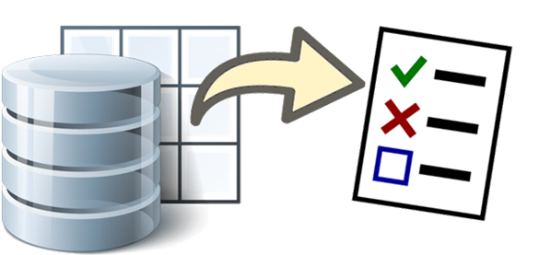
Data-Driven Testing

Slide 43
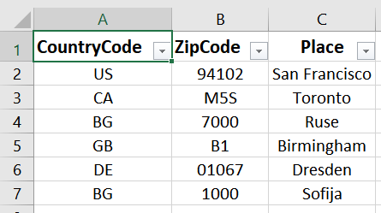
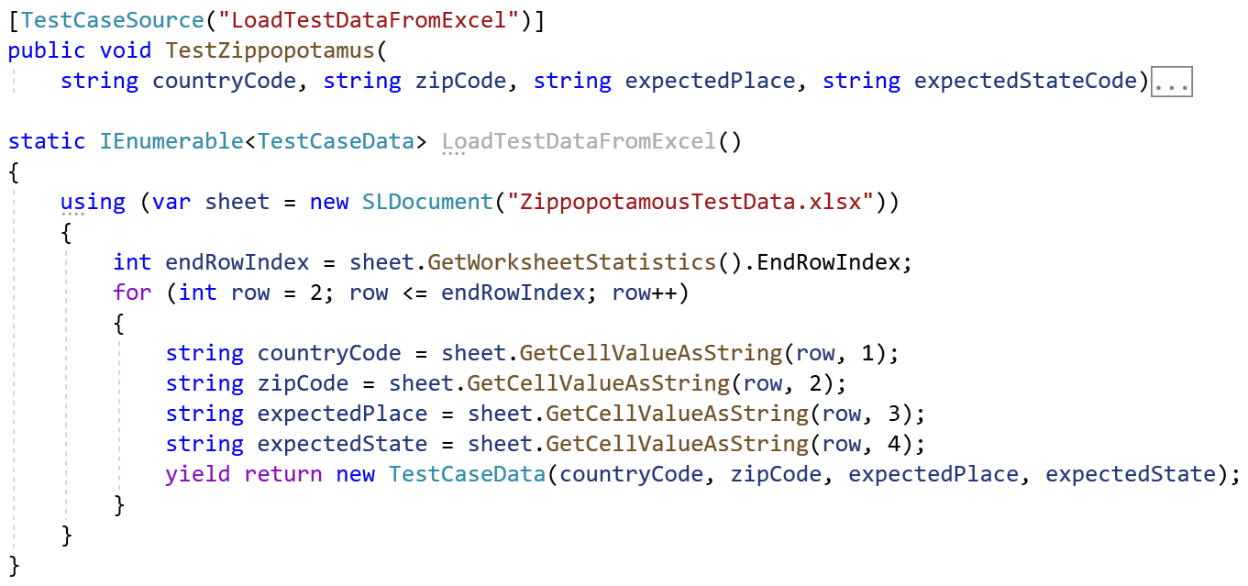
Data-Driven Testing
Data-driven testing == running the same test case with multiple data (e. g. datasets in the C# code / Excel spreadsheet)
Data Set
Testing Scripts
Data-driven testing framework: code and data stored separately

Slide 44
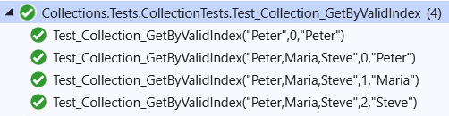
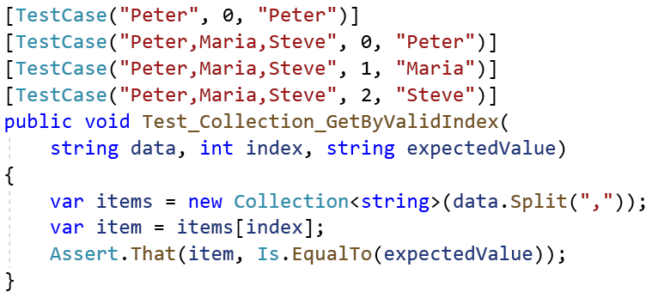
Data-Driven Testing with NUnit (1)
The [TestCase] attribute in NUnit assigns multiple datasets in test method parameters

Slide 45
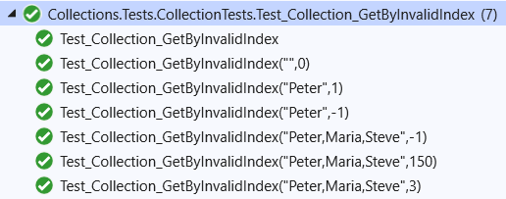
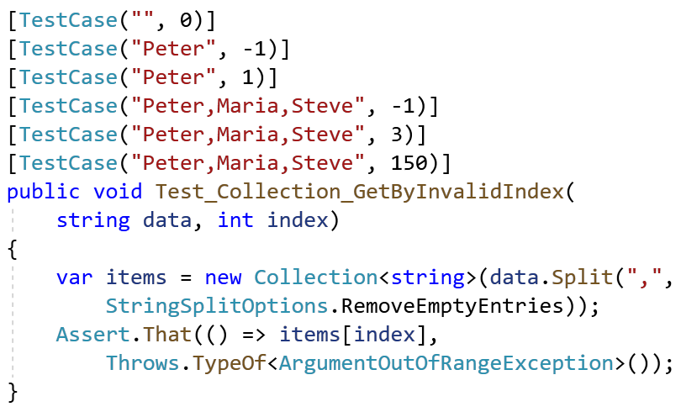
Data-Driven Testing with NUnit (2)
Another example

Slide 46
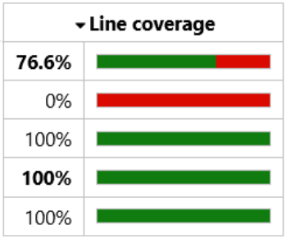
Checking the Lines Covered by the Tests

Slide 47
Code Coverage
Code coverage tools measure how many lines of code (LOC) are covered by the test execution
Lines executed at least once are colored in green
Lines never executed (untested lines) are red
Partially executed lines are orange
The code coverage for the automated tests is an important metric in software engineering
Code coverage of 70 - 80% is a reasonable goal for most projects

Slide 48
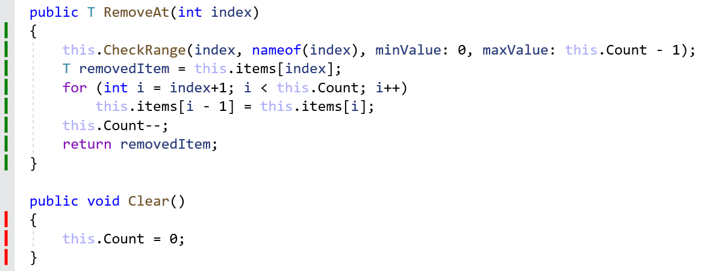
Code Coverage: Examples (1)
This code was fully covered by the tests
This code was NOT covered by the tests

Slide 49
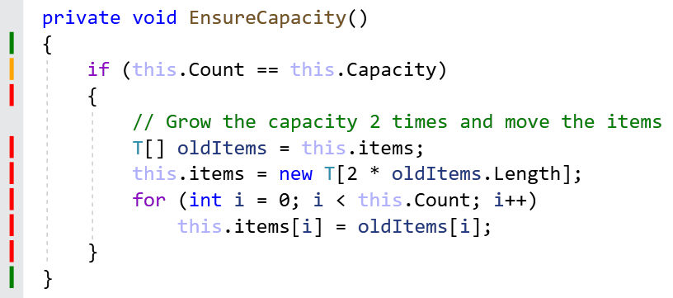
Code Coverage: Examples (2)
This code was only partially executed during the tests
We need a test for the "grow capacity" use case

Slide 50
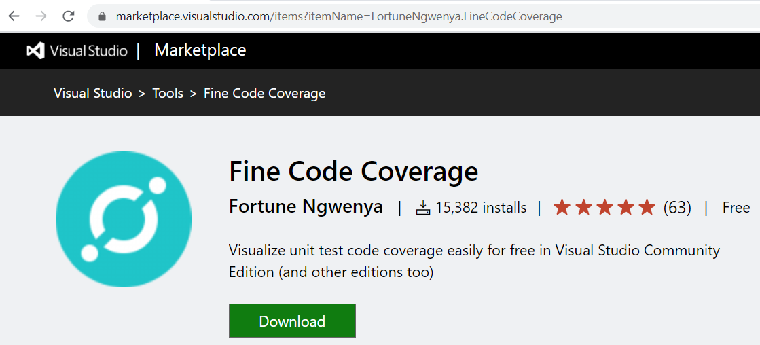
Code Coverage Tools for C#
Visual Studio supports code coverage for C# only in the Enterprise edition (paid product)
Alternative: the Fine Code Coverage free extension for VS
https://bit.ly/321wf8A

Slide 51
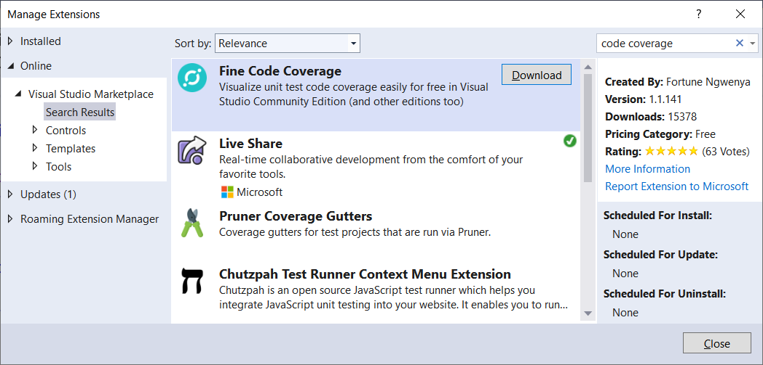

Installing "Fine Code Coverage" in VS

Slide 52
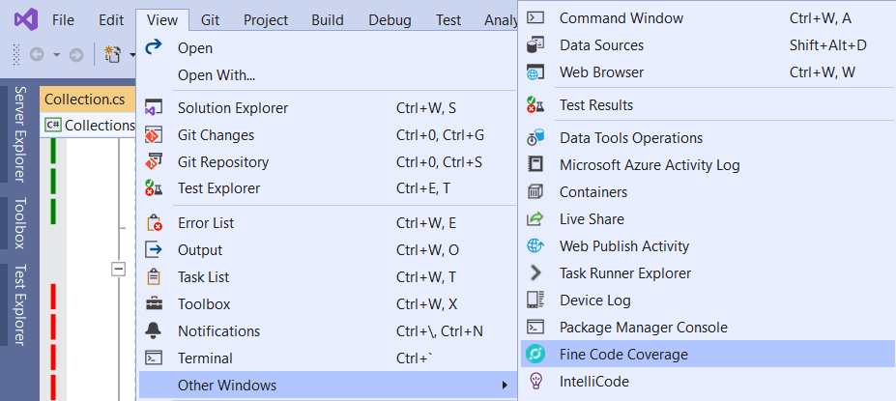
Activating "Fine Code Coverage" in VS
Run the unit tests to view the covered lines in green / red / orange (be patient, the coloring comes after a while)
View your code coverage report in the [Fine Code Coverage] window

Slide 53

Naming, Repeatable, No Dependencies

Slide 54


Naming the Test Methods
Test names should answer the question "what's inside?"
Should use business domain terminology
Should be descriptive and readable
IncrementNumber() {}
Test1() {}
TestTransfer() {}
Test_DepositAddsMoneyToBalance() {}
Test_DepositNegativeShouldNotAddMoney() {}
Test_TransferSubtractsFromSourceAddsToDestAccount() {}

Slide 55
Automated Tests: Good Practices (1)
Test cases must be repeatable
Tests should behave the same if you run them many times
The expected results must be consistent and easily verified
Test cases should have no dependencies
The order of test execution should never be important
Input data and entrance conditions should be set in the test
Test cases may depend on the test initialization only: [SetUp]
Tests should cleanup properly any resources used

Slide 56
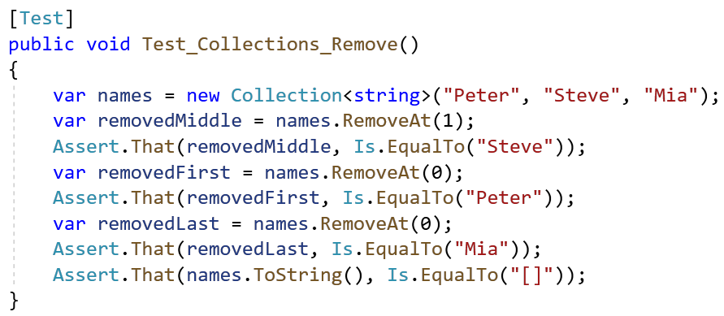
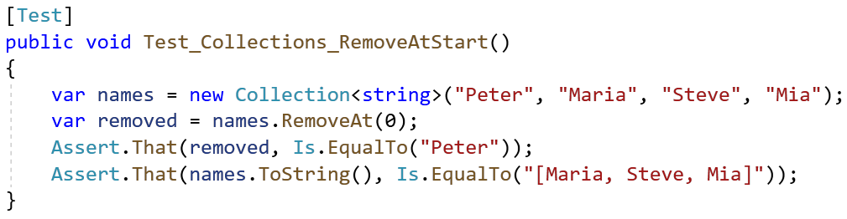

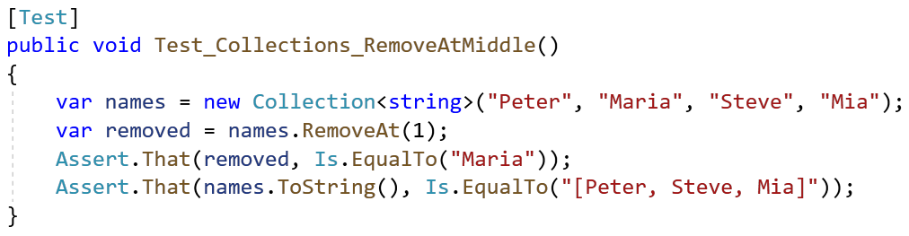

Automated Tests: Good Practices (2)
Single scenario per test case, not multiple

Slide 57
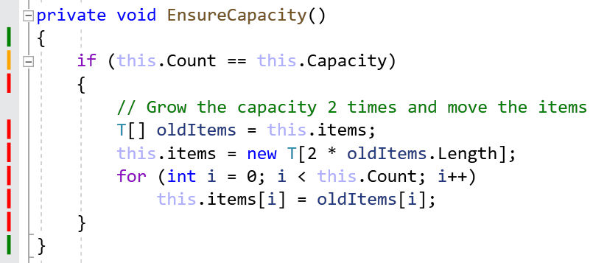
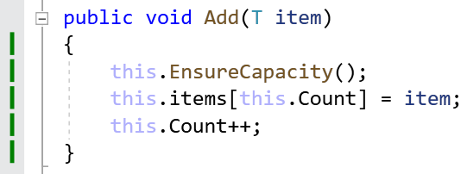
Testing Private Methods
Private methods should be tested indirectly
By testing the public methods with certain inputs and entrance conditions, that will invoke the target private methods
Check the code coverage to ensure all code is tested!
Example:

Slide 58

Summary
Unit testing == automated testing of single component (unit)
Testing framework == foundation for writing tests
NUnit == automated testing framework for C#
The AAA pattern: Arrange, Act, Assert
Assertion == checking results / exit conditions
Code coverage == tracks which LOC are executed
Notes:
58

Slide 59
Questions?
Notes:
59

Slide 60

License
This course (slides, examples, demos, exercises, homework, documents, videos and other assets) is copyrighted content
Unauthorized copy, reproduction or use is illegal
© SoftUni – https://softuni.org
© Software University – https://softuni.bg
Notes:
60

